Slide 1
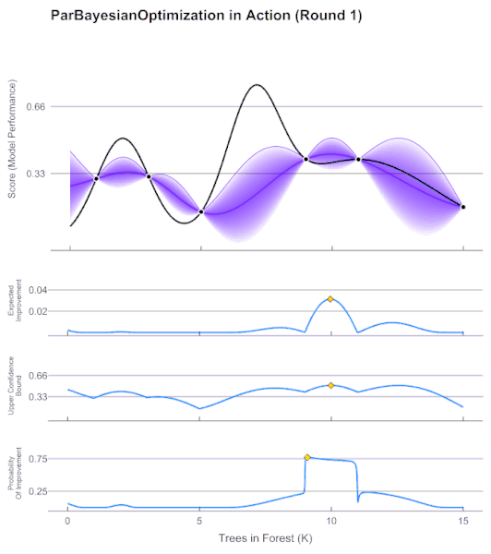
Bayesian Optimization
Feb.19.2020
Team . A
Kwangwoon University ML Study
Week #11

Slide 2
Bayesian Optimization
Machine Learning is
Extremely powerful
But Tuning Machine Learning system is
Extremely non-intuitive

Slide 3
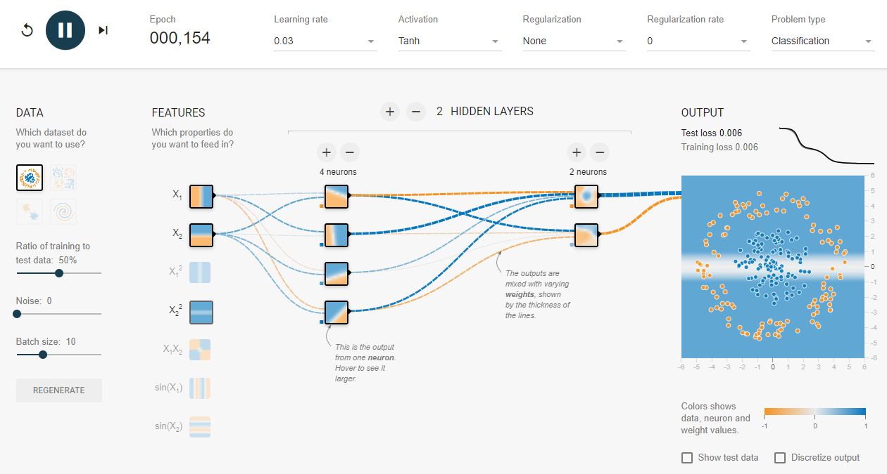
Bayesian Optimization
https://playground.tensorflow.org/

Slide 4
Bayesian Optimization
Many Tunable parameters in Machine learning

Slide 5
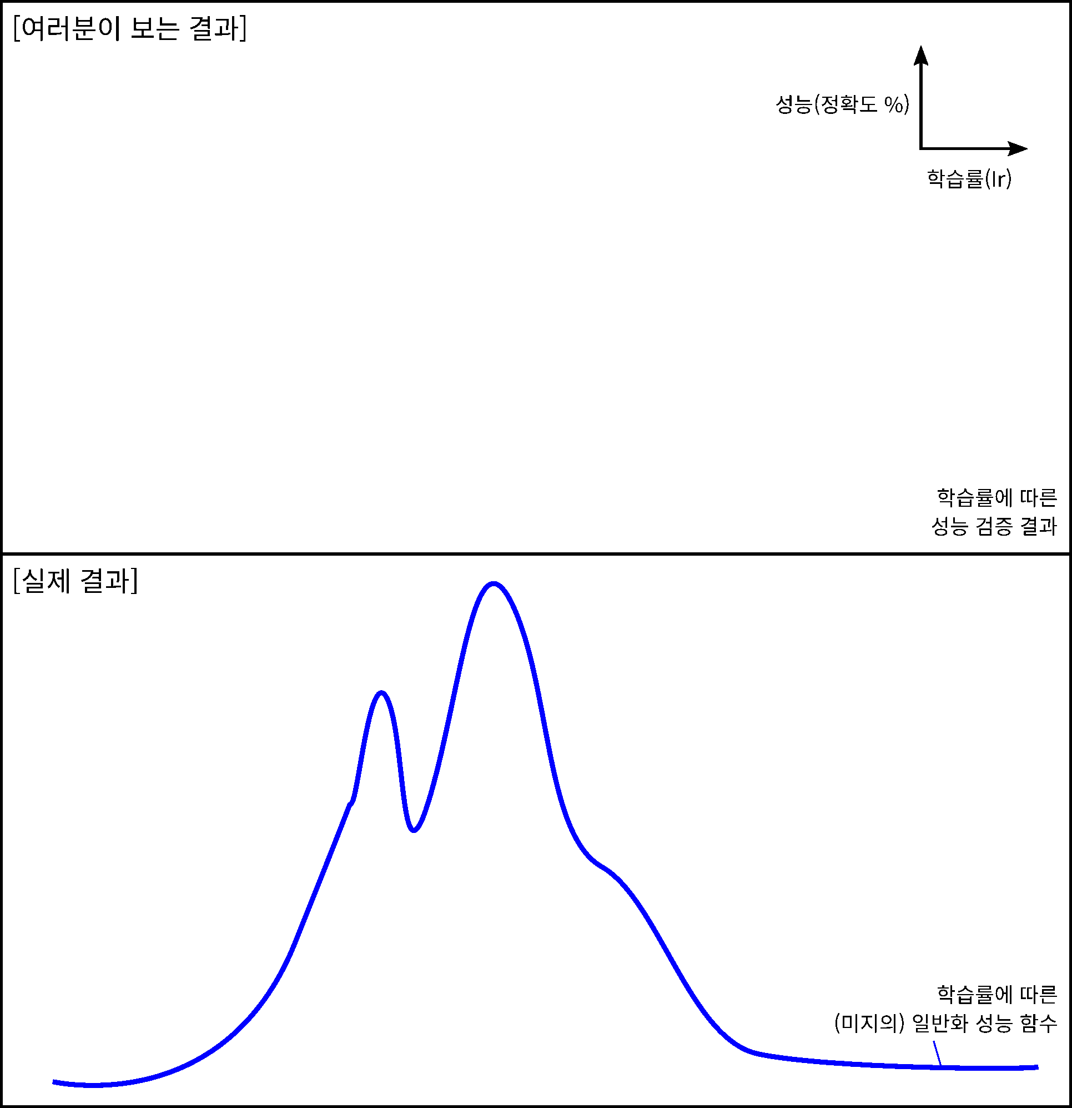
Bayesian Optimization

Slide 6
Bayesian Optimization
Manual Search
Select hyperparameter manually
with using prior knowledge
and intuition
Notes:
Manual search는 말 그대로 사람이 노하우 또는 직관rhk 같은
사전 지식을 이용하여 하이퍼파라미터의 후보 값들을 정하여 성능 결과를 구합니다.
그 후보 값들 중 가장 성능 결과가 높은 하이퍼 파라미터 값을 선택하는 아주 간단한 방법입니다.

Slide 7
Bayesian Optimization
Manual Search
Problem
It doesn’t guarantee that the solution is truly optimal.
As the number of hyperparameters increases, the problem becomes more complex
Notes:
그러나 옆의 예시를 보면 알 수 있듯이 최적을 보장하기 어렵고, hyper parameter의 수가 늘어날 수록 문제가 복잡해지는 것을 알 수 있습니다.

Slide 8
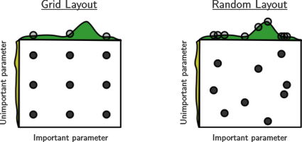
Bayesian Optimization
Grid Search
Select all hyperparameter
within the certain section
at regular intervals

Slide 9
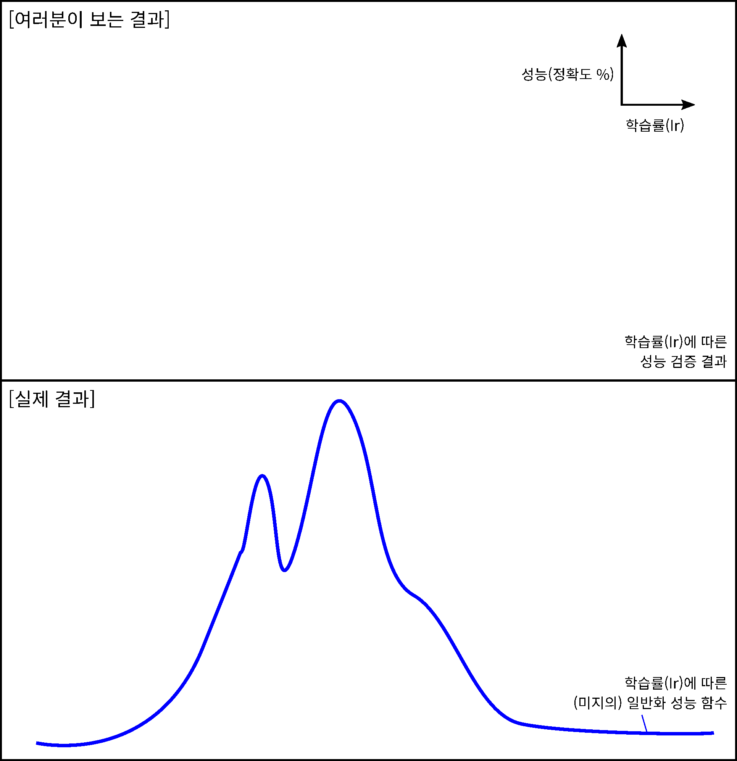
Bayesian Optimization
Grid Search
Problem
As the number of hyperparameters increases, the problem becomes more complex
There is no exploitation
Notes:
Manual search보다는 좀 더 전역적인 탐색이 가능하다는 장점이 있지만,
Grid search 역시 hyperparameter의 개수가 많아질수록 탐색에 필요한 계산 량이
기하급수적으로 증가한다는 단점이 있습니다.
또한 이전 조사 과정에서 얻은 성능 결과가 다음 파라미터 값을 선정할 때 전혀 고려되지 않는다는 단점이 있습니다. 즉 exploitation이 없다는 것입니다.

Slide 10
Bayesian Optimization
Random Search
Select hyperparameter
by random sampling
Advantage
Reduce the number of iteration
The values located between grids can also be stochastically searched
Notes:
Random search는 말 그대로 랜덤하게 하이퍼파라미터의 후보 값을 선정하는 것으로,
Grid search에 비해 불필요한 반복 수행 횟수를 줄일 수 있고, 간격 사이에 위치한 값들 또한 확률적으로 탐색이 가능합니다. 따라서 grid 탐색보다는 더 빨리 최적 값을 찾을 수 있습니다.

Slide 11
Bayesian Optimization
Random Search
Problem
As the number of hyperparameters increases, the problem becomes more complex
There is no exploitation
Notes:
그러나 random search도 마찬가지로 이전의 시도들의 결과가 다음 파라미터 값을 선정할 때 전혀 영향을 미치지 않습니다. 따라서 어느정도 비효율적일수 밖에 없습니다.

Slide 12
Bayesian Optimization
Exploration-Exploitation
Dilemma
Manual Search
Grid/Random Search
Exploration Exploitation
Bayesian
Optimization
Notes:
grid search나 random search는 exploration는 충분하지만, exploitation이 없다는 것을 알 수 있습니다.
따라서 탐색과 착취를 적절히 병행해야 할 필요가 있는데요, 이 방식이 바로 Bayesian optimization입니다.

Slide 13
Common Approach
Random search or grid search
Expert defined grid search near “good” points
Refine domain and repeat steps - “grad student descent”
Problem
Expert intensive
Computationally intensive
Finds potentially local optima
Does not fully exploit useful information

Slide 14
Common Approach
Optimize some Overall Evaluation Criterion (OEC)
Loss, Accuracy, Likelihood, Revenue
Given tunable parameters
Hyperparameters, feature parameters
In an efficient way
Sample function as few times as possible
Training on big data is expensive

Slide 15

Common Approach
Default
Prediction
With tunable ML parameters
Model Optimizer
Prediction Accuracy
DATA
Model
Optimally suggests
new parameters
New parameters

Slide 16
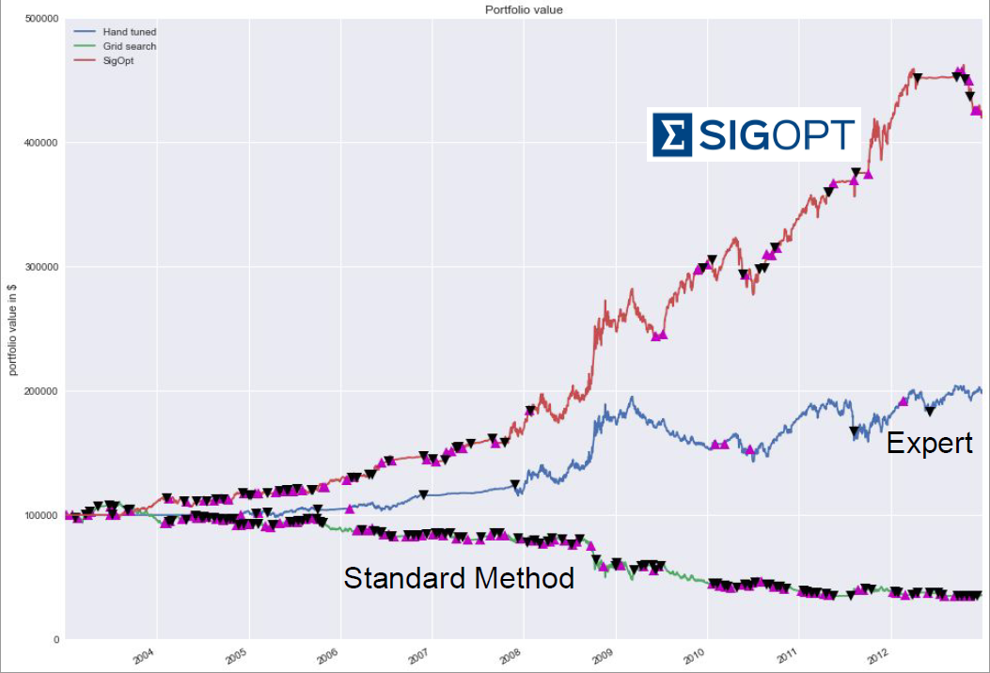
Common Approach
BO based Optimizer

Slide 17
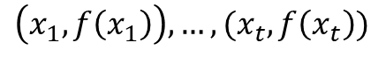
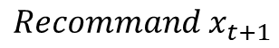
Bayesian Optimization
Optimization
Find optimal solution $x^{∗}$ that maximize ${f(x)}^{ }$
Suggest Two essential element
Surrogate Model
Acquisition Function
$$\left(x_{1},f\left(x_{1}\right)\right),…,(x_{t},f\left(x_{t}\right))$$
$$Recommand x_{t+1}$$
Probabilistic Estimation of Unknown Objective Function
Recommend candidate values to help you find the optimal input value

Slide 18
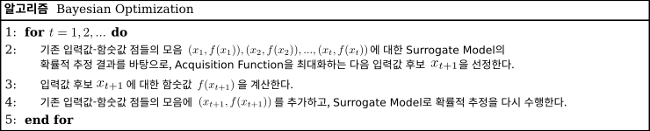
Bayesian Optimization
Optimization
Find optimal solution $x^{∗}$ that maximize ${f(x)}^{ }$
Suggest Two essential element
Pseudo-code for BO algorithm

Slide 19
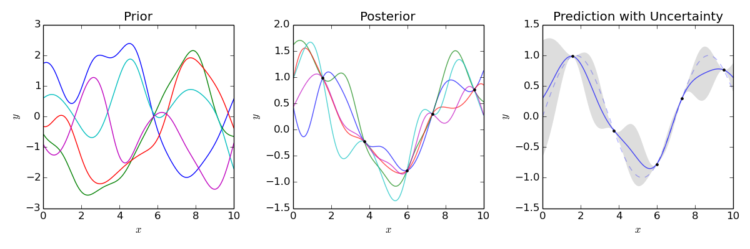
Bayesian Optimization
Surrogate Model
Gaussian Processes(GP)
$$f(x)∼GP(μ(x),k(x,x′))$$
Gaussian process uses lazy learning and a measure of the similarity between points (the kernel function) to predict the value for an unseen point from training data
Gaussian processes can be seen as an infinite-dimensional generalization of multivariate normal distributions

Slide 20
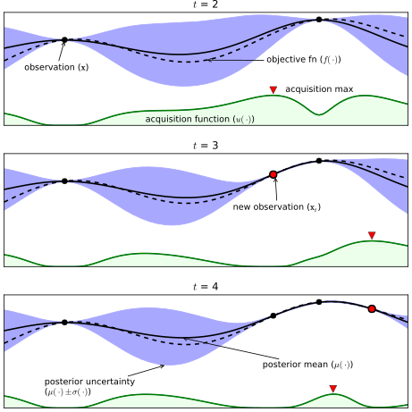
Bayesian Optimization
Surrogate Model
Gaussian Processes(GP)
black dotted line : Actual object function
Black line : Estimated avg function
Blue space : Estimated Standard deviation
Black dots : searched input-function output point

Slide 21
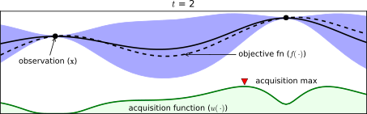
Bayesian Optimization
Acquisition Function
Trade-off
Exploitation vs Exploration

Slide 22
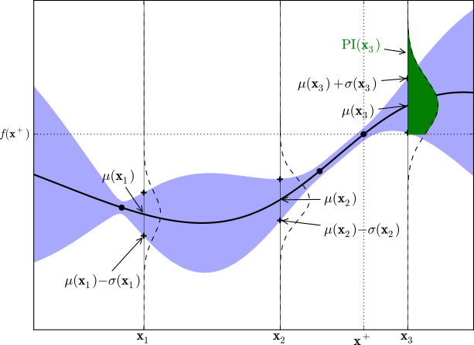
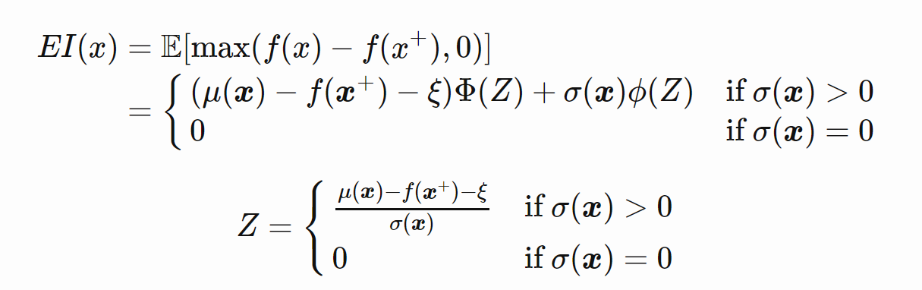
Bayesian Optimization
Acquisition Function
Expected Improvement (EI)

Slide 23
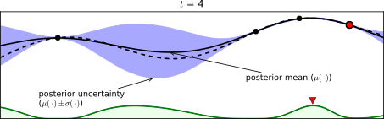
Bayesian Optimization
Acquisition Function
Expected Improvement (EI)

Slide 24
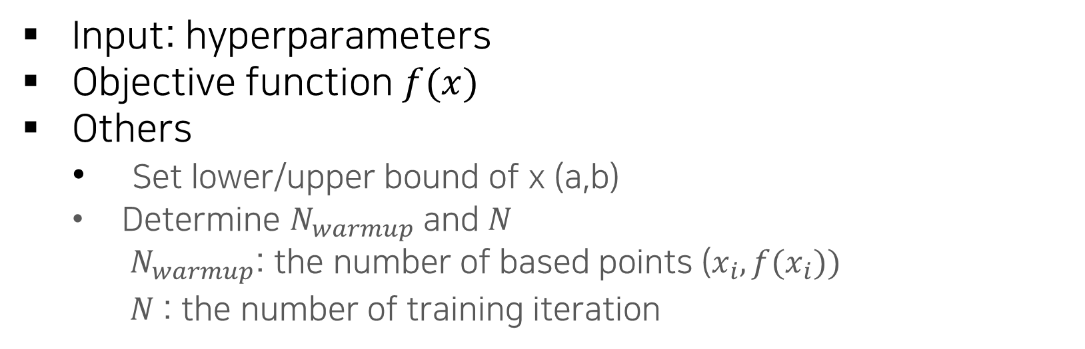
Bayesian Optimization
Define input, object function $f$ and other setting values.
Input: hyperparameters
Objective function $f(x)$
Others
Set lower/upper bound of x (a,b)
Determine $N_{warmup}$ and $N$
$N_{warmup}$: the number of based points ($x_{i},{f(x}_{i}))$
$N$: the number of training iteration
Notes:
𝑁_𝑤𝑎𝑟𝑚𝑢𝑝: 처음 조사할 점들의 개수

Slide 25
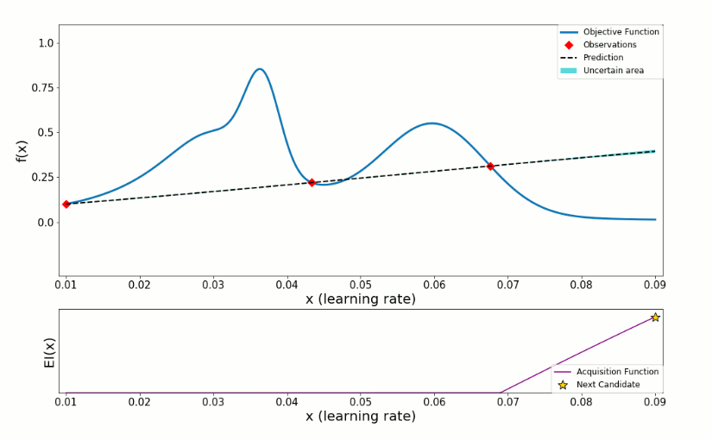
Bayesian Optimization
Warmup Phase
select $x_{i}$ with random sampling and calculate $f(x_{i})$ (1<= $i$ < =$N_{warmup}$)

Slide 26
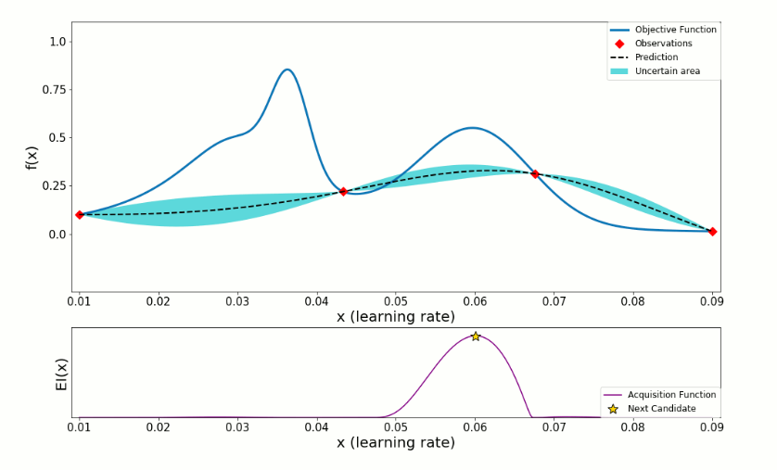

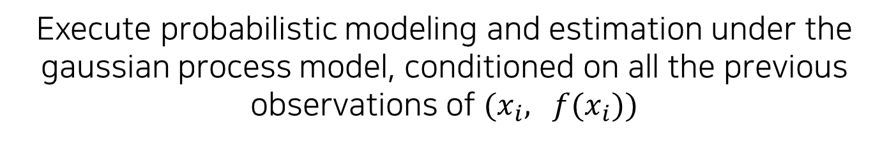
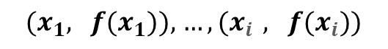
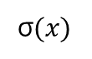
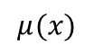
Bayesian Optimization
σ$(x)$
${(x}_{1},$ $f(x_{1})),$ ${…,(x}_{i},$ $f(x_{i}))$
$$μ(x)$$
σ$(x)$, $μ(x)$
Execute probabilistic modeling and estimation under the gaussian process model, conditioned on all the previous observations of ${(x}_{i},$ $f(x_{i}))$

Slide 27
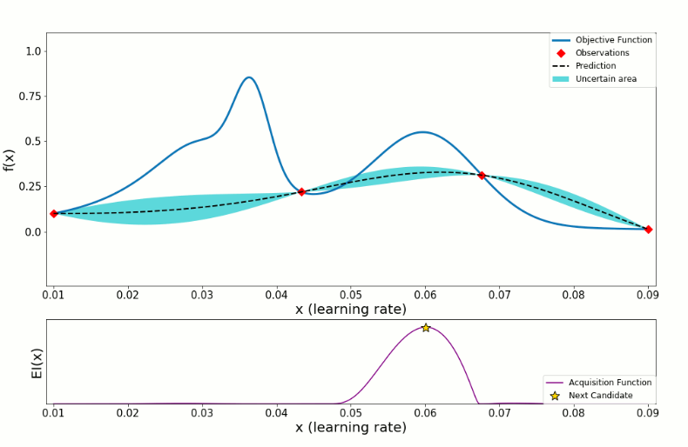
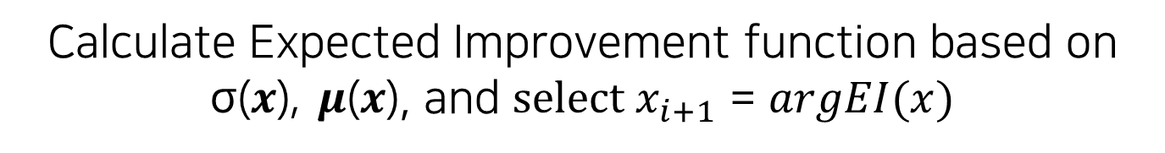
Bayesian Optimization
Calculate Expected Improvement function based on σ(𝒙), 𝝁(𝒙), and $select x_{i+1}$ = $argEI(x)$

Slide 28
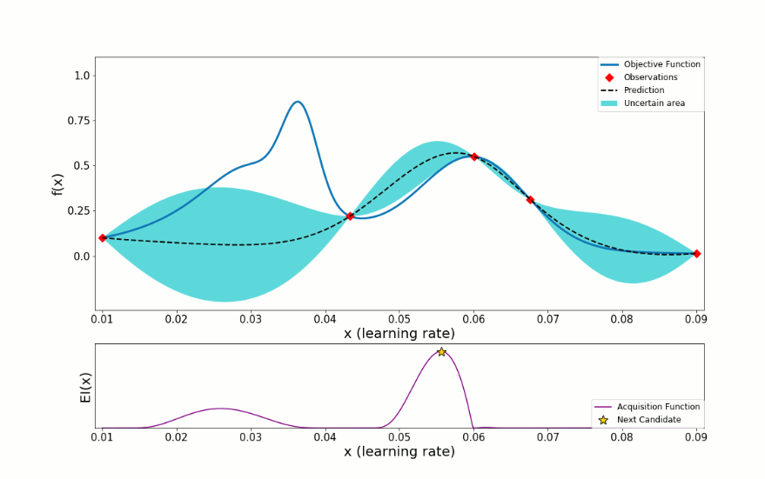
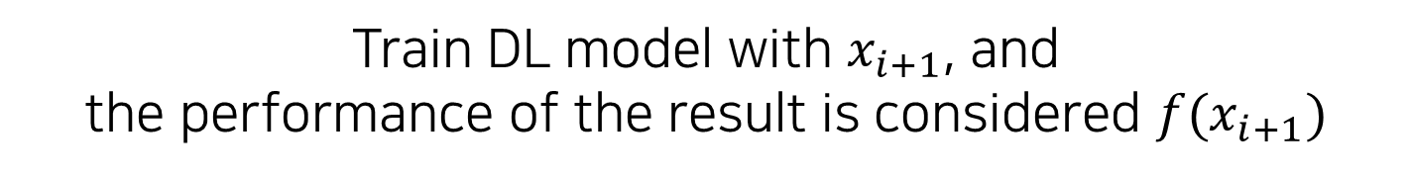
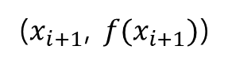
Bayesian Optimization
($x_{i+1}$, $f(x_{i+1})$)
Train DL model with $x_{i+1}$, and
the performance of the result is considered $f(x_{i+1})$
Notes:
Xi+1일 때의 학습 모델의 성능 결과를 계산하여, f(xi+1)의 값으로 취급한다.

Slide 29
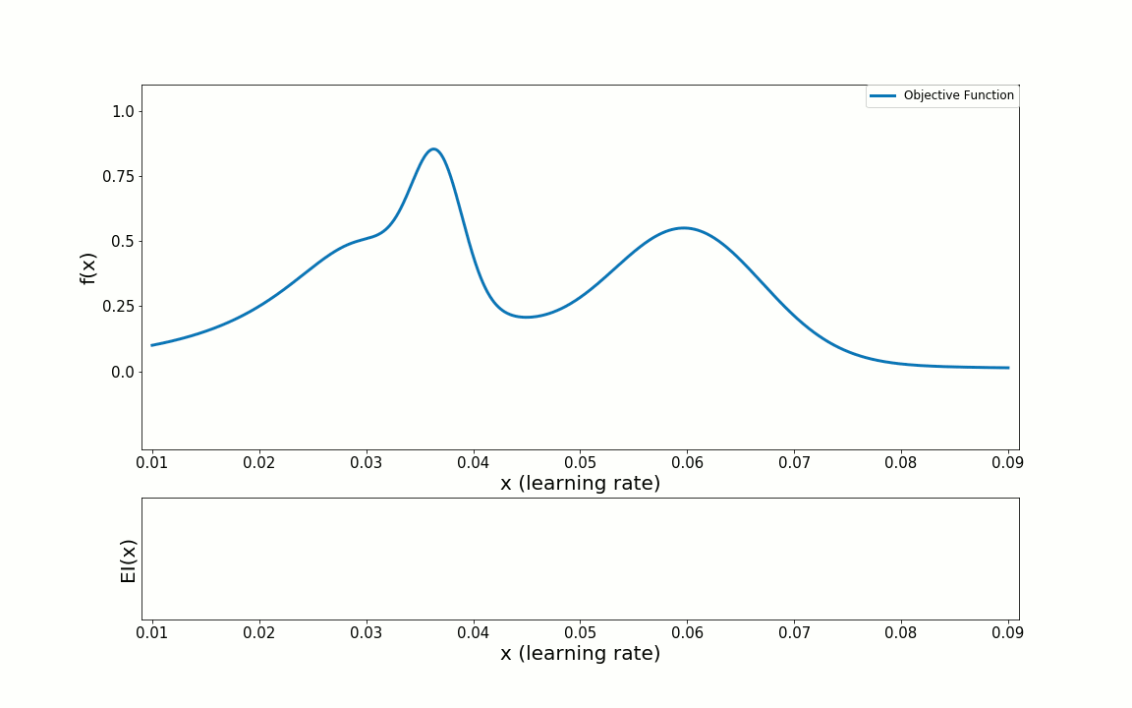
Bayesian Optimization
Repeat Upper process until the number of iteration is equal to $N$

Slide 30
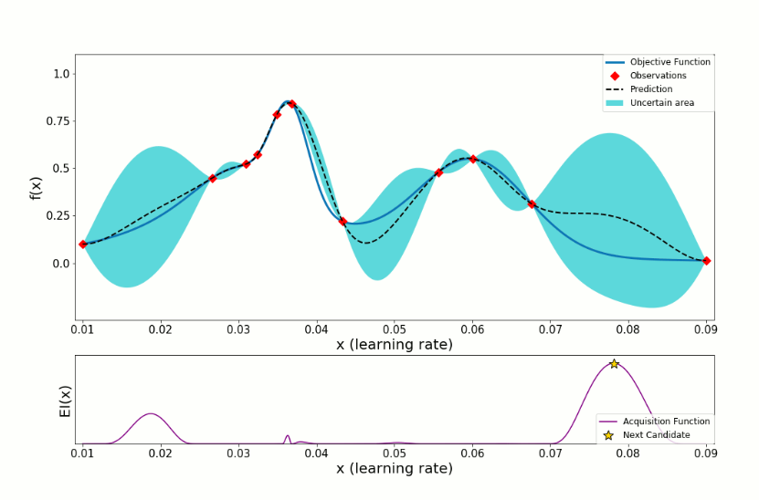
Bayesian Optimization
Select $x^{∗}$ that maximize $μ(x)$ based on objective function

Slide 31
Bayesian Optimization

Slide 32
Bayesian Optimization
BO works better than others in practice

Slide 33
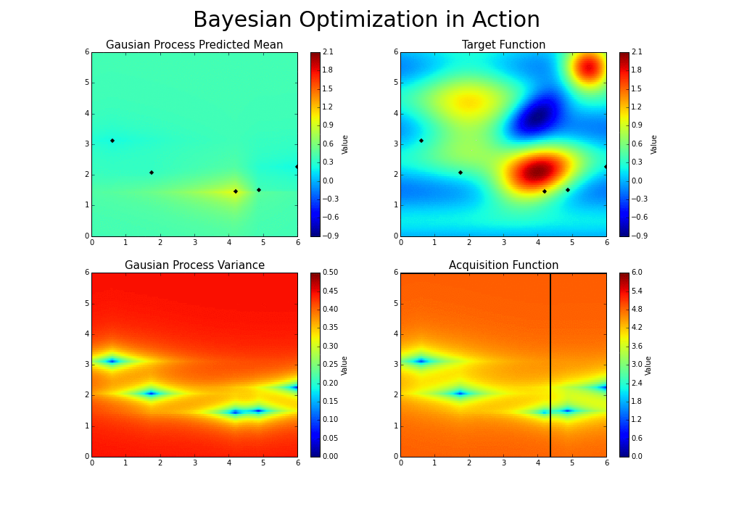
Bayesian Optimization

Slide 34
Common Approach
SMBO
Sequential Model-Based Optimization

Slide 35
Common Approach
Build Gaussian Process (GP) with points
Optimize the fit of the GP (covariance
Find the point(s) of highest Expected Improvement within parameter domain
Return optimal next best point(s) to sample

